Slide 1
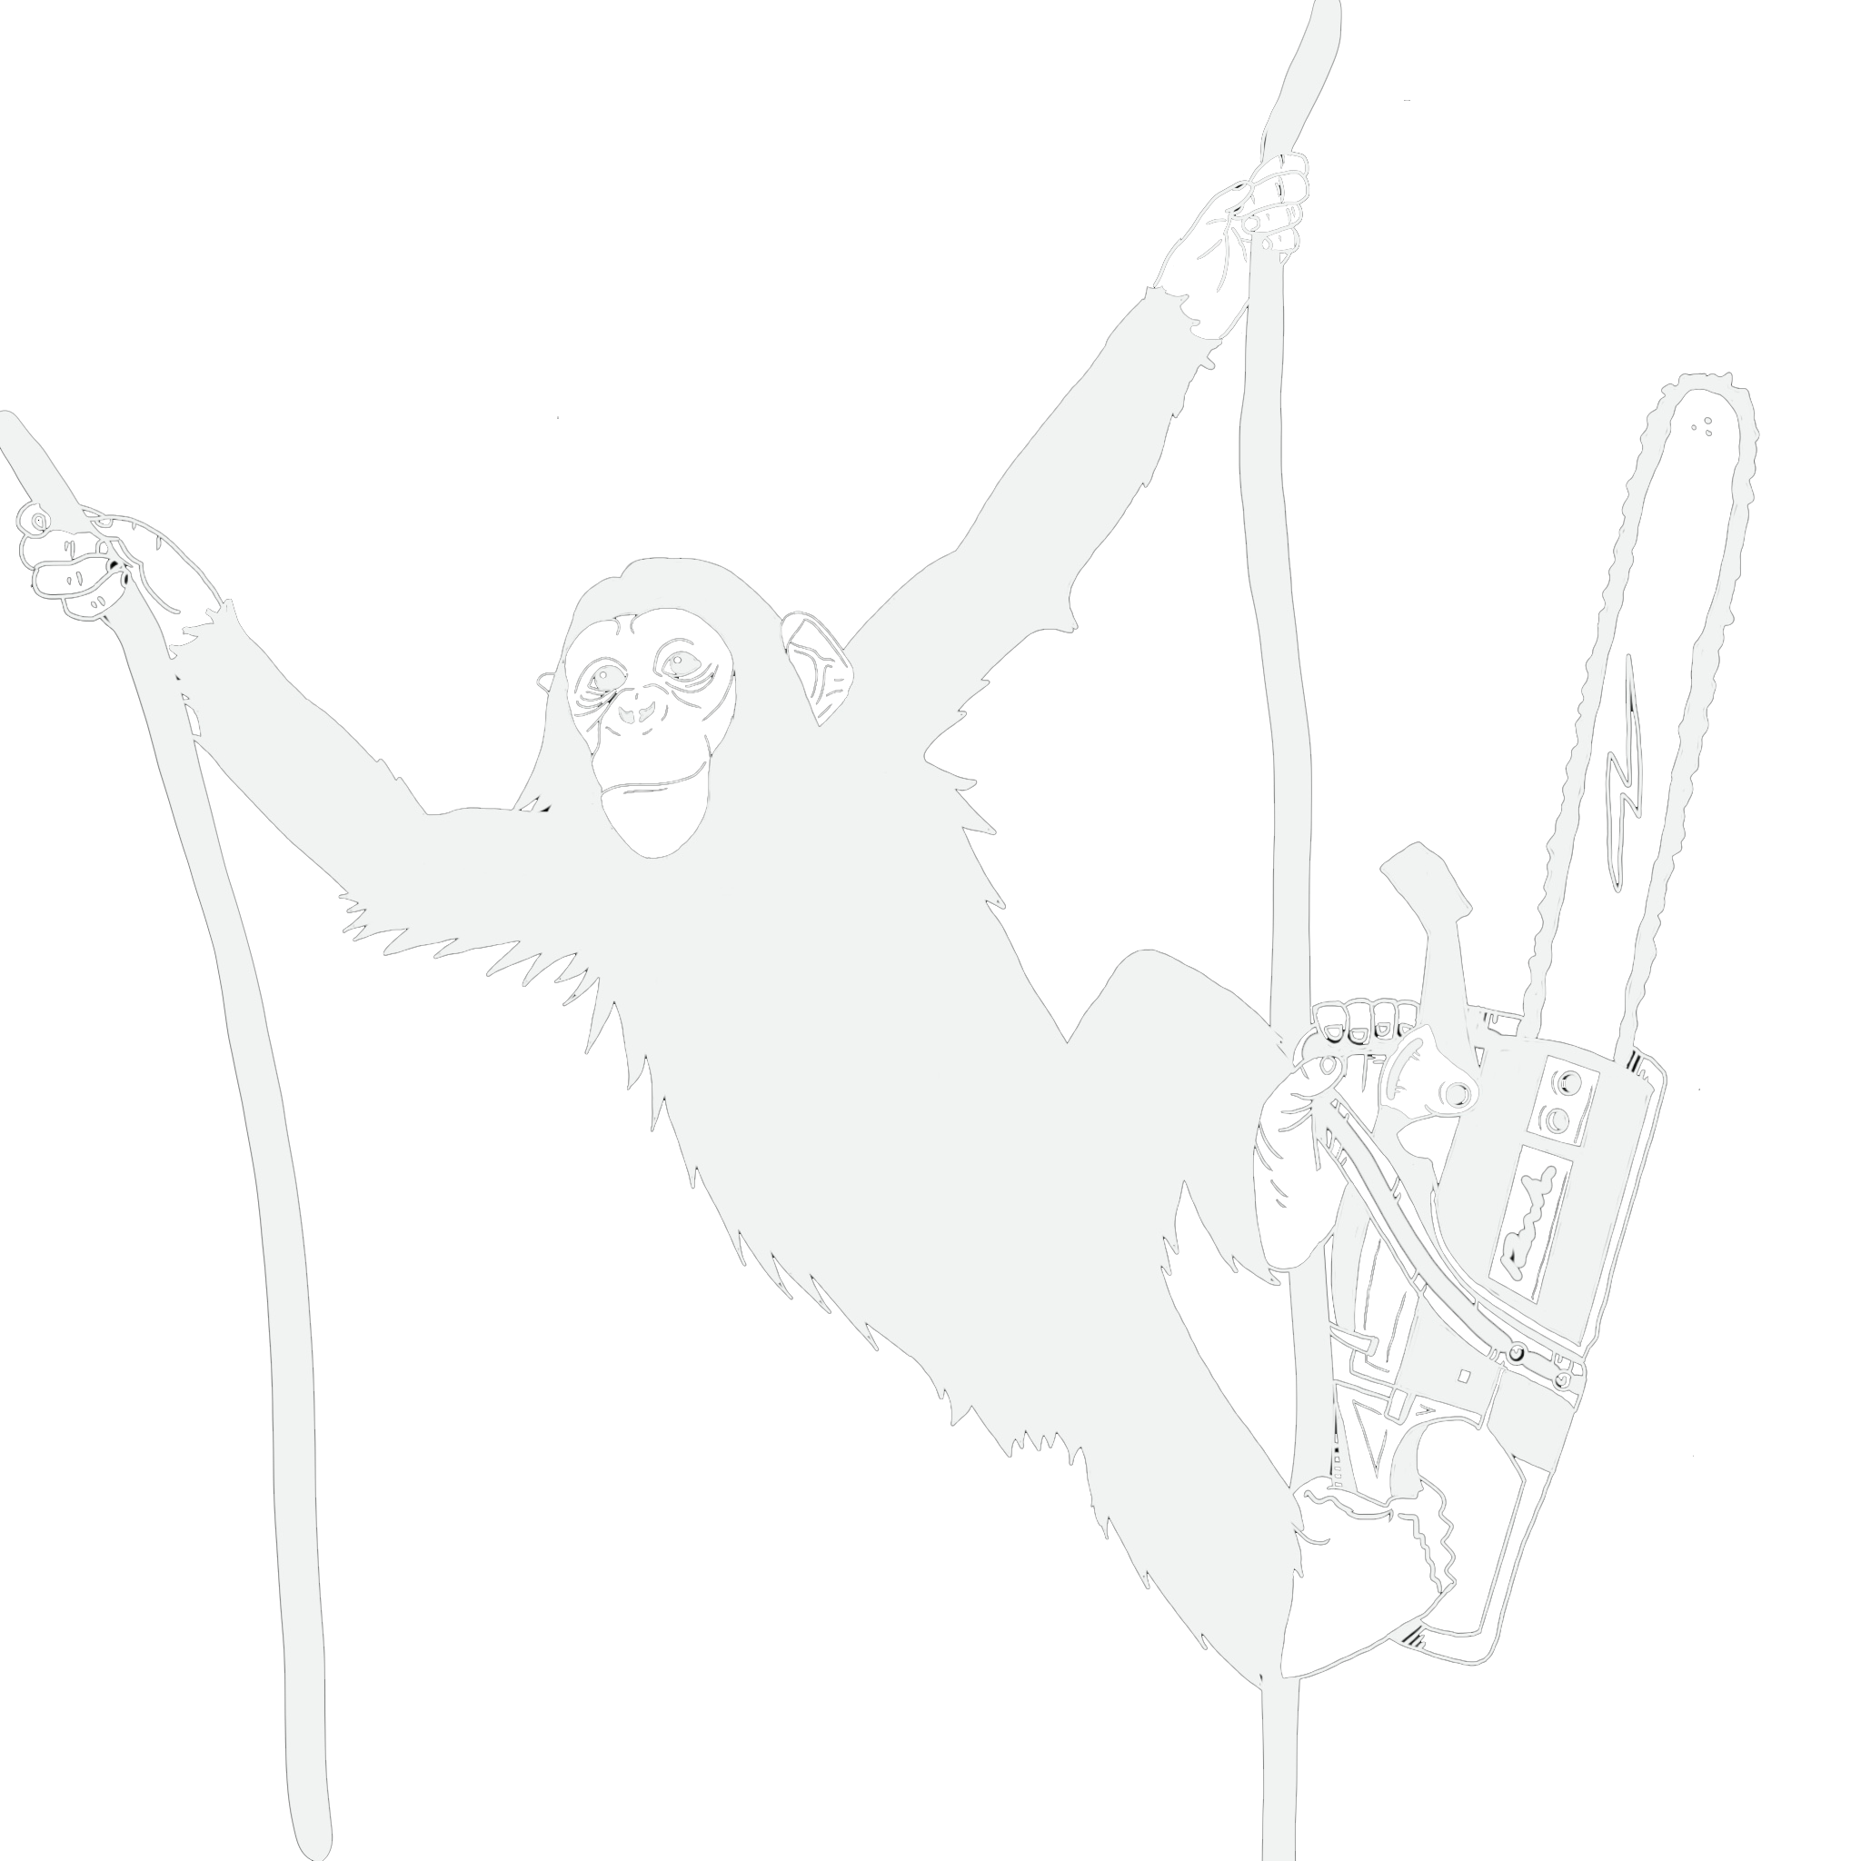
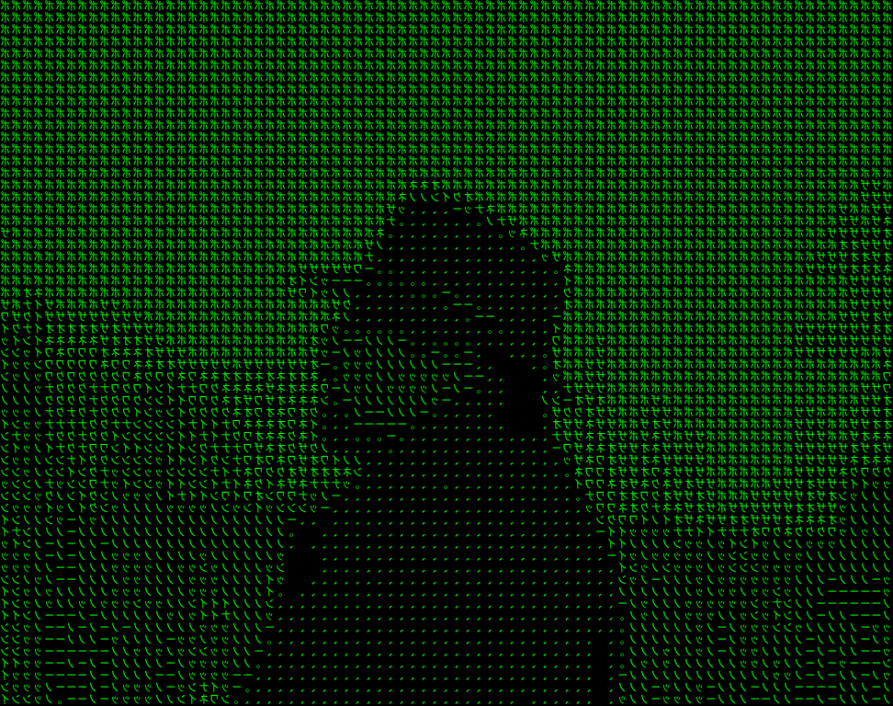
Security & Cryptography
Prof. Darrell Long
CSE 13S

Slide 2
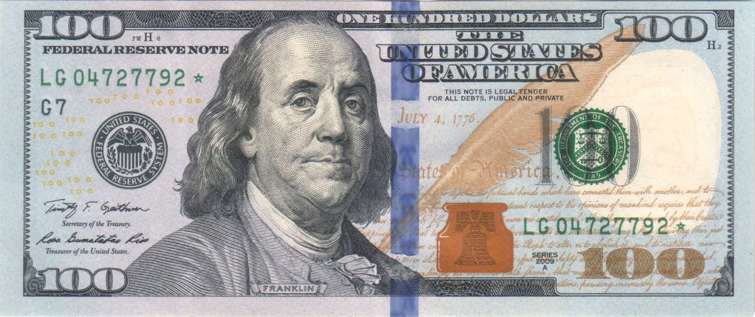

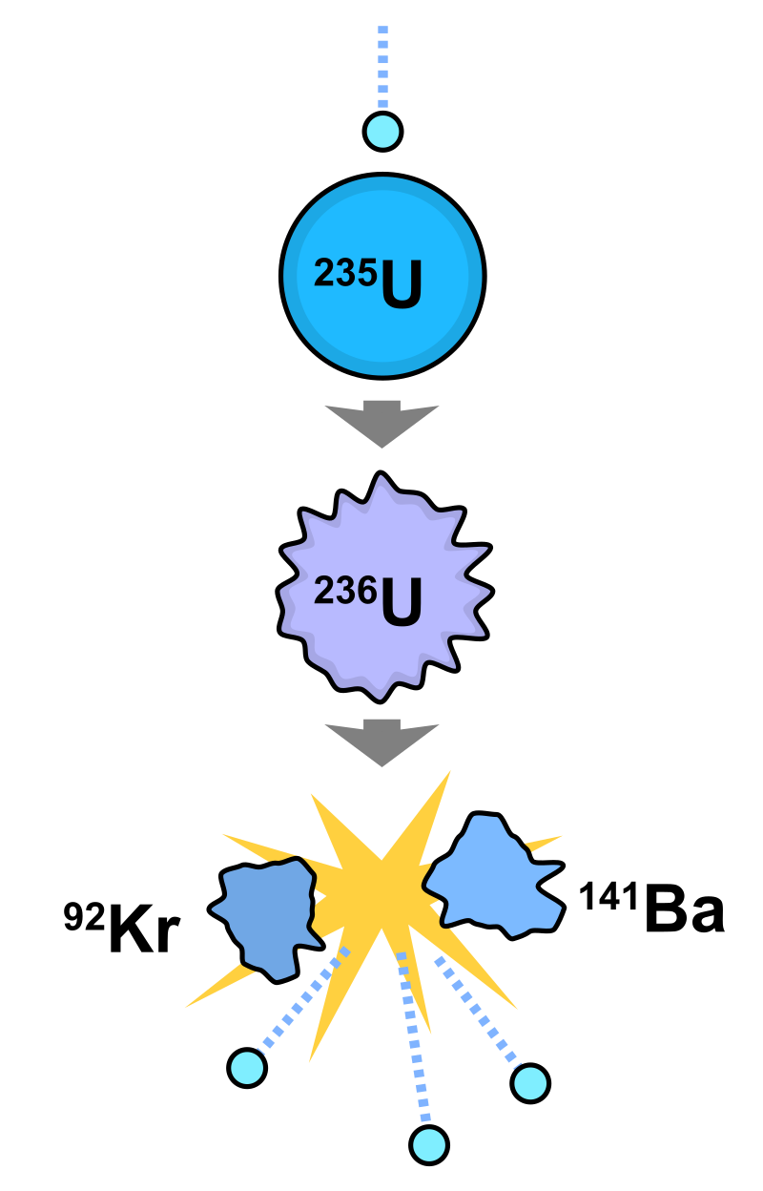


Security Threats
But why!??
For the fun of it …
Financial gain …
Commercial advantage …
Espionage …
Terrorism …
Goal | Threat
Data confidentiality | Exposure of data
Data integrity | Tampering with data
System availability | Denial of service
Cryptography
Cryptography
Engineering

Slide 3






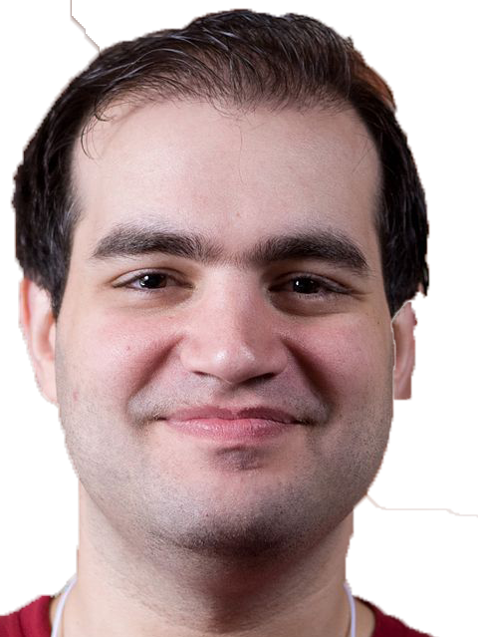



Who are your adversaries?
If they target you, they will get you.
Vast Gulf
Sophistication
Budget

Slide 4
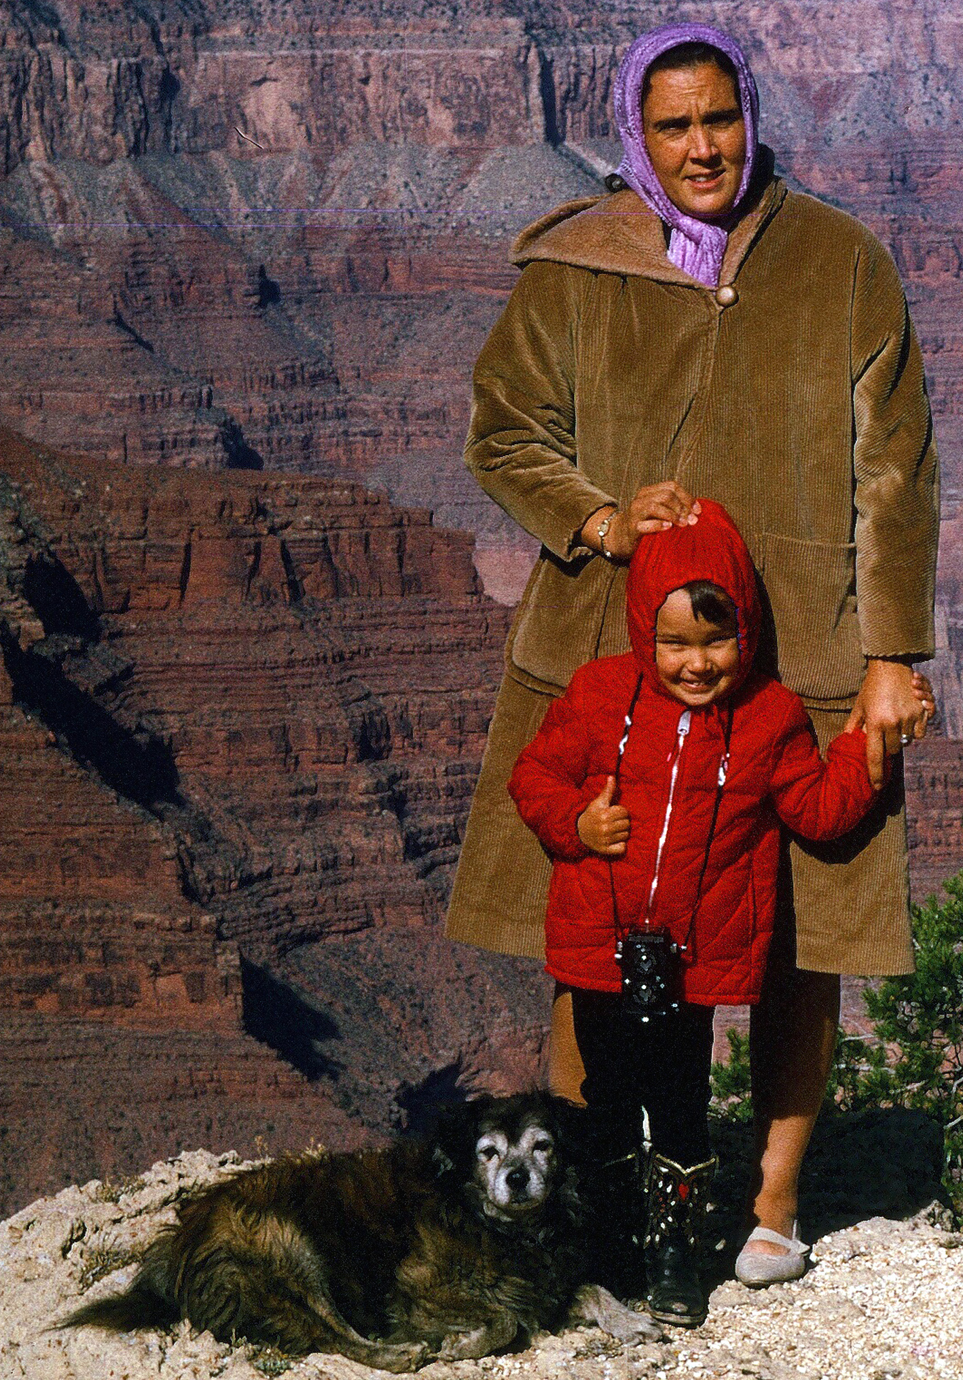
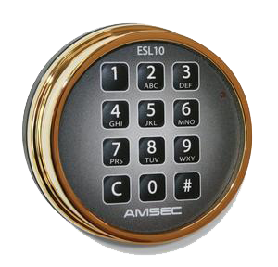
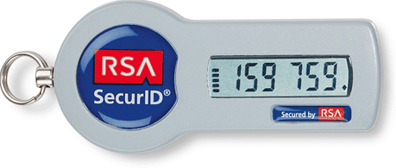
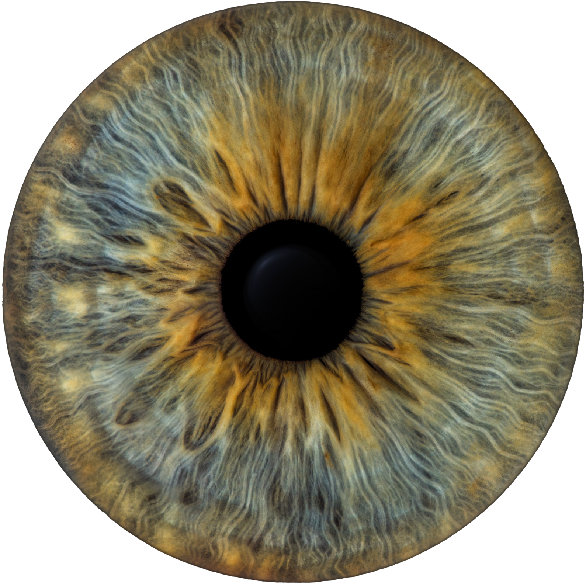

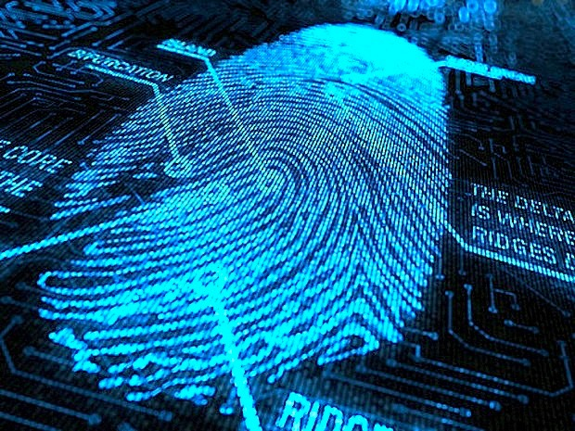
First, you must prove who you are!
Something that you know,
Something that you have,
Something that you are.

Slide 5
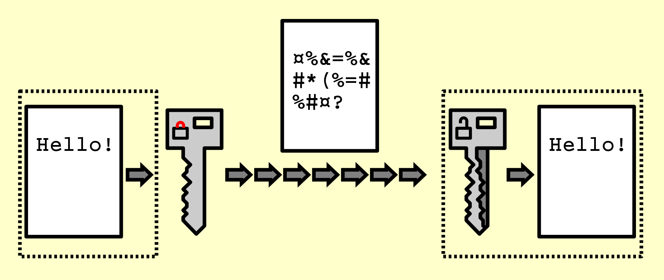
Cryptography
Ciphertext
Plaintext
Plaintext
Goal: Render a message incomprehensible to all except the intended recipient.
Requirement: Use a well-known algorithm to encrypt.
But why?
Relying upon the secrecy of the algorithm is a very bad idea:
German Enigma
Japanese Purple
Algorithm has two inputs: data & key
Key is known only to authorized users.
Key
Key

Slide 6
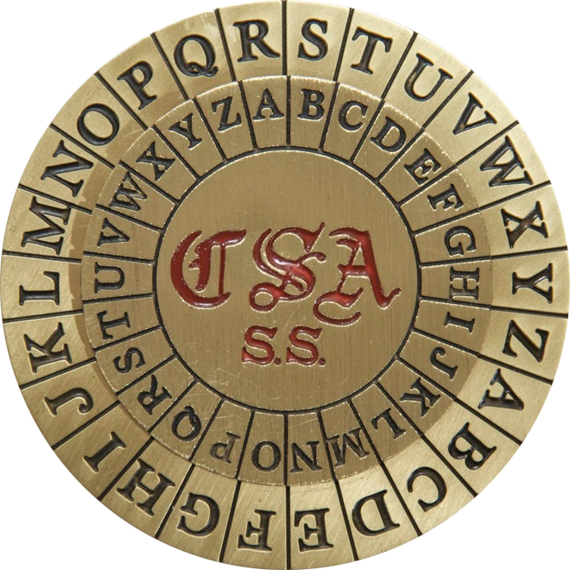
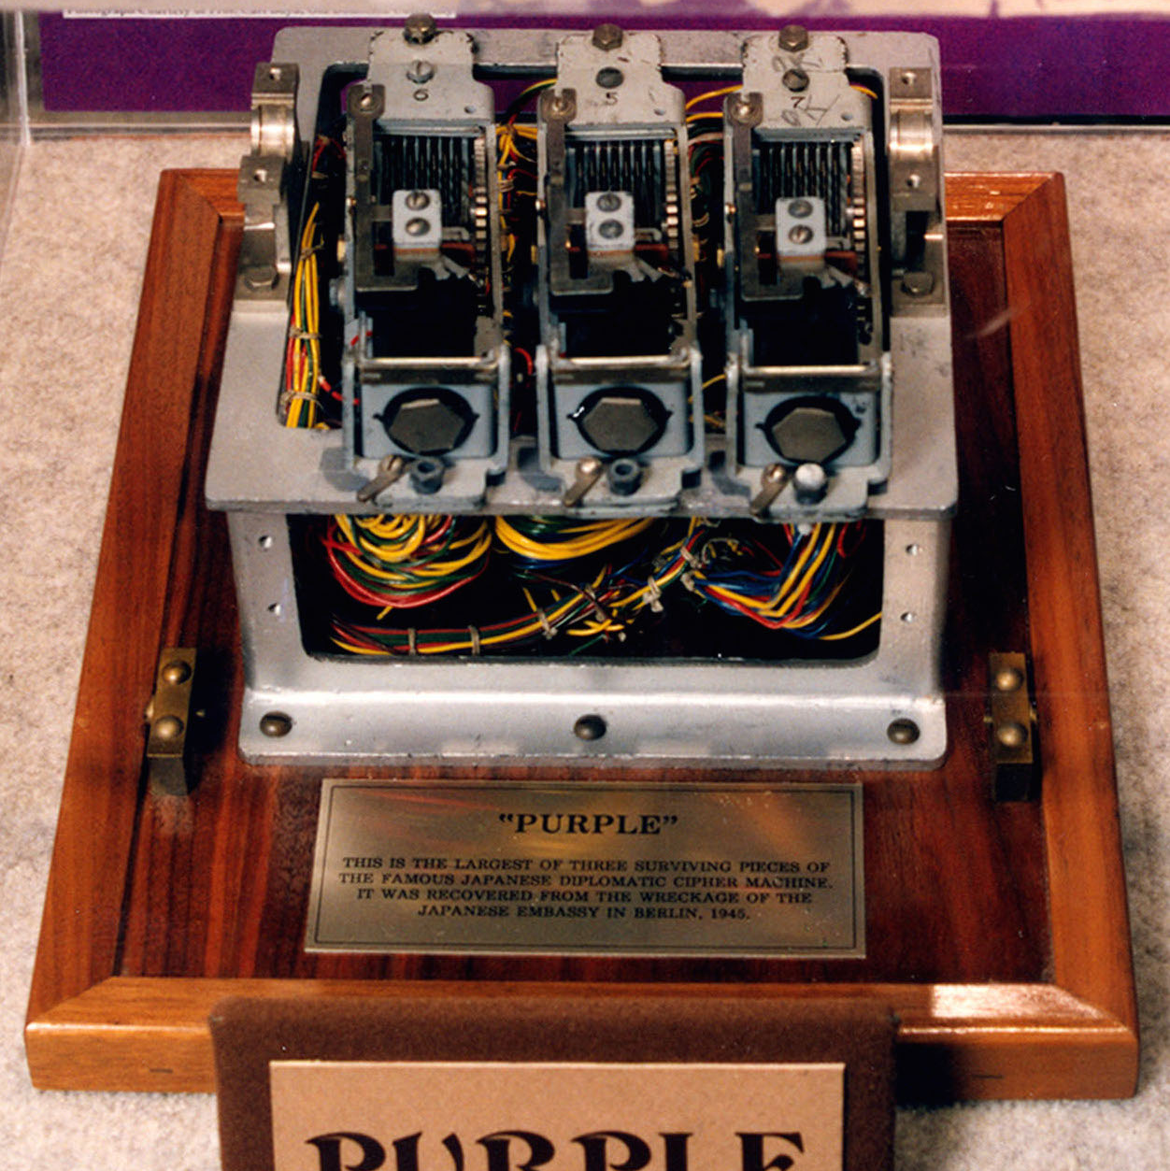
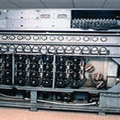
Kerckhoffs’s desideratum
Summary: The only secret should be the key.
The system must be practically, if not mathematically, indecipherable;
It should not require secrecy, and it should not be a problem if it falls into enemy hands;
It must be possible to communicate and remember the key without using written notes, and correspondents must be able to change or modify it at will;
It must be applicable to telegraph communications;
It must be portable, and should not require several persons to handle or operate;
Lastly, given the circumstances in which it is to be used, the system must be easy to use and should not be stressful to use or require its users to know and comply with a long list of rules.

Slide 7
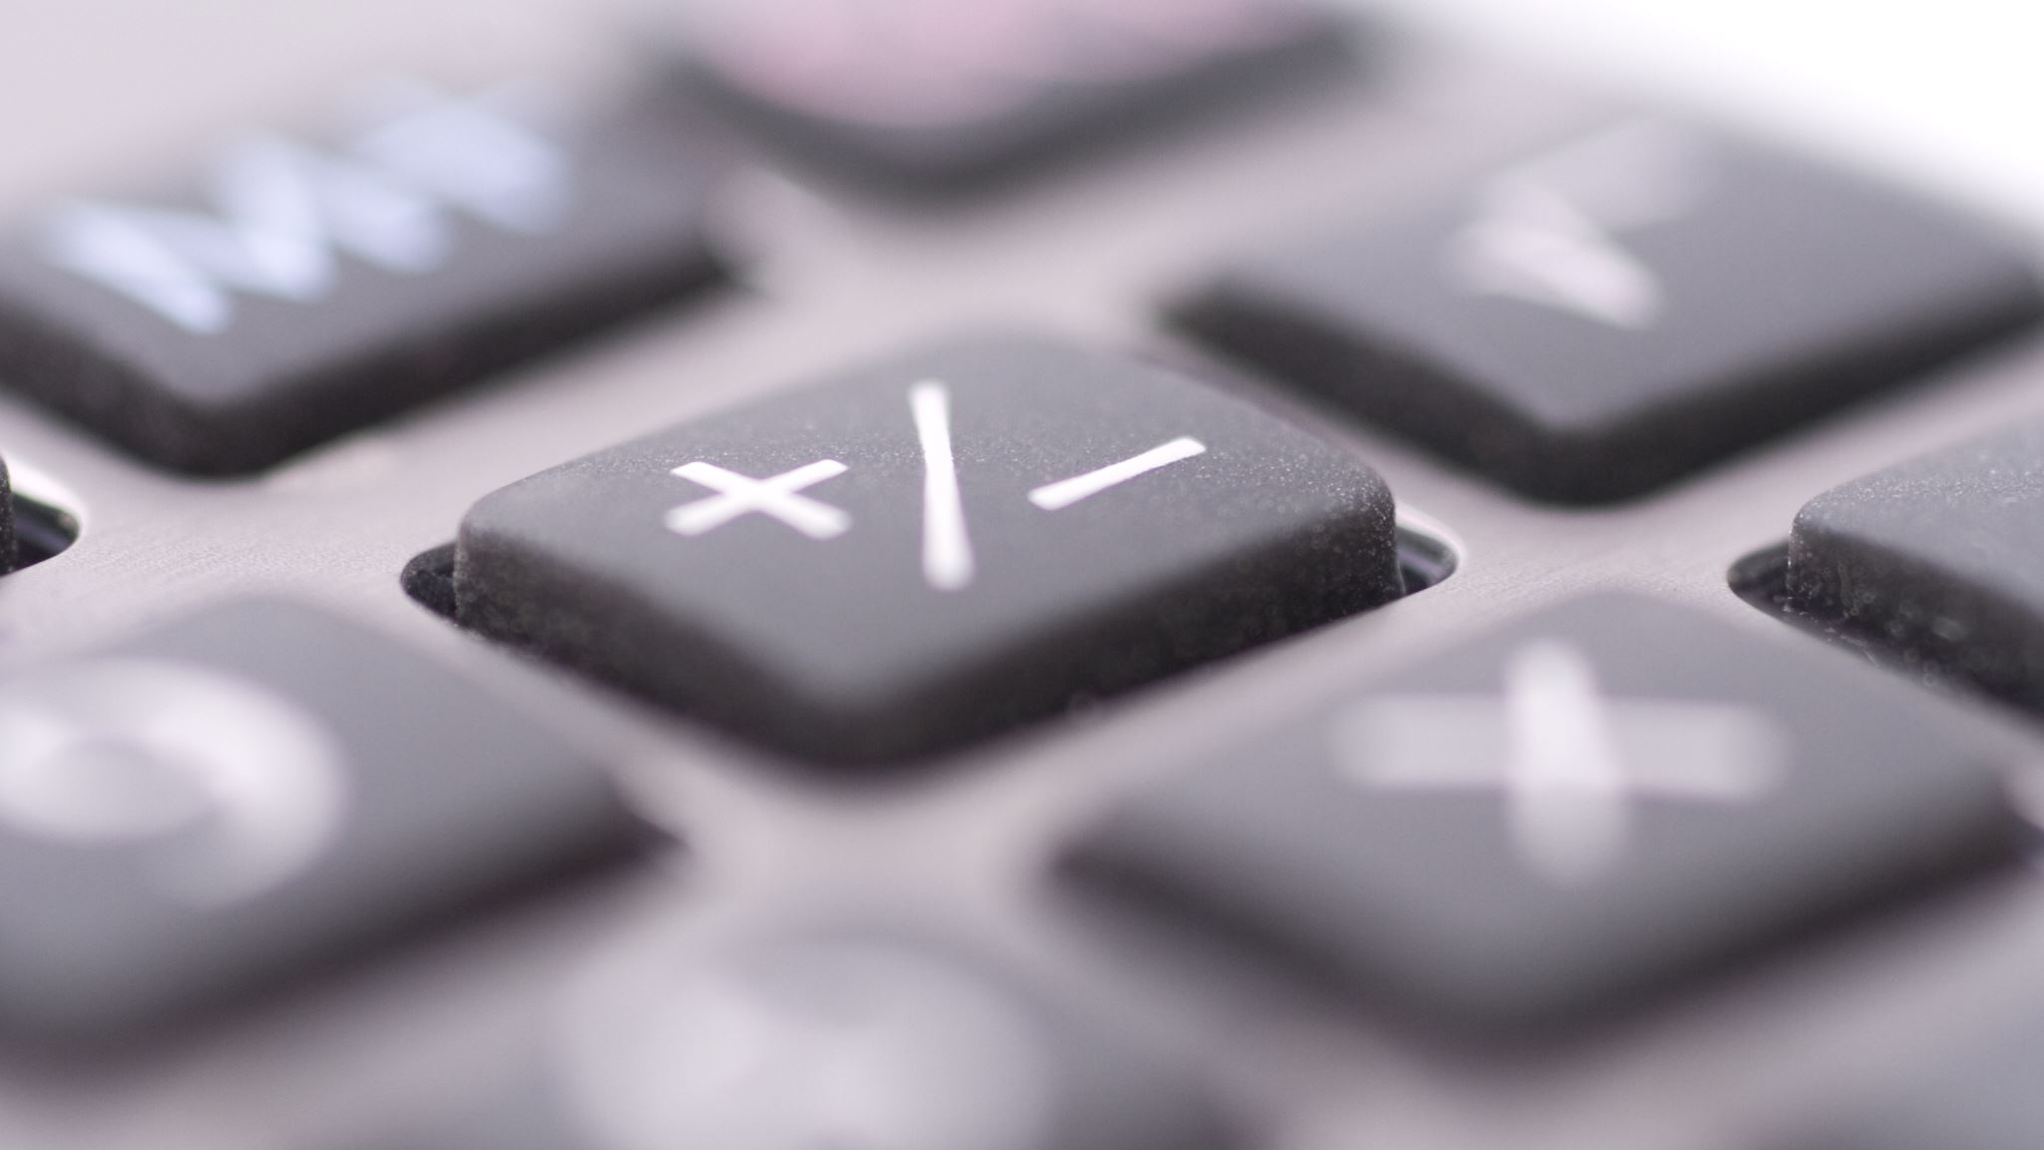
Algorithms (E, D) are publicly known.
Keys (K_{E}, K_{D}) represent a shared secret.
The ciphertext should be the only information that’s available to the world.
The plaintext is known only to the people with the keys.
Cryptography Basics
K_{E}
K_{D}
Encryption key
Decryption key
E
C=E(P,KE)
D
P
P
Plaintext
Ciphertext
Plaintext
Encryption
Decryption

Slide 8
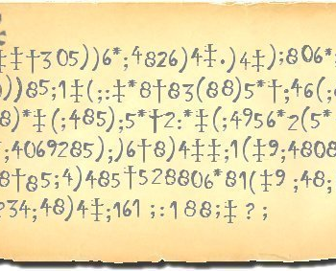
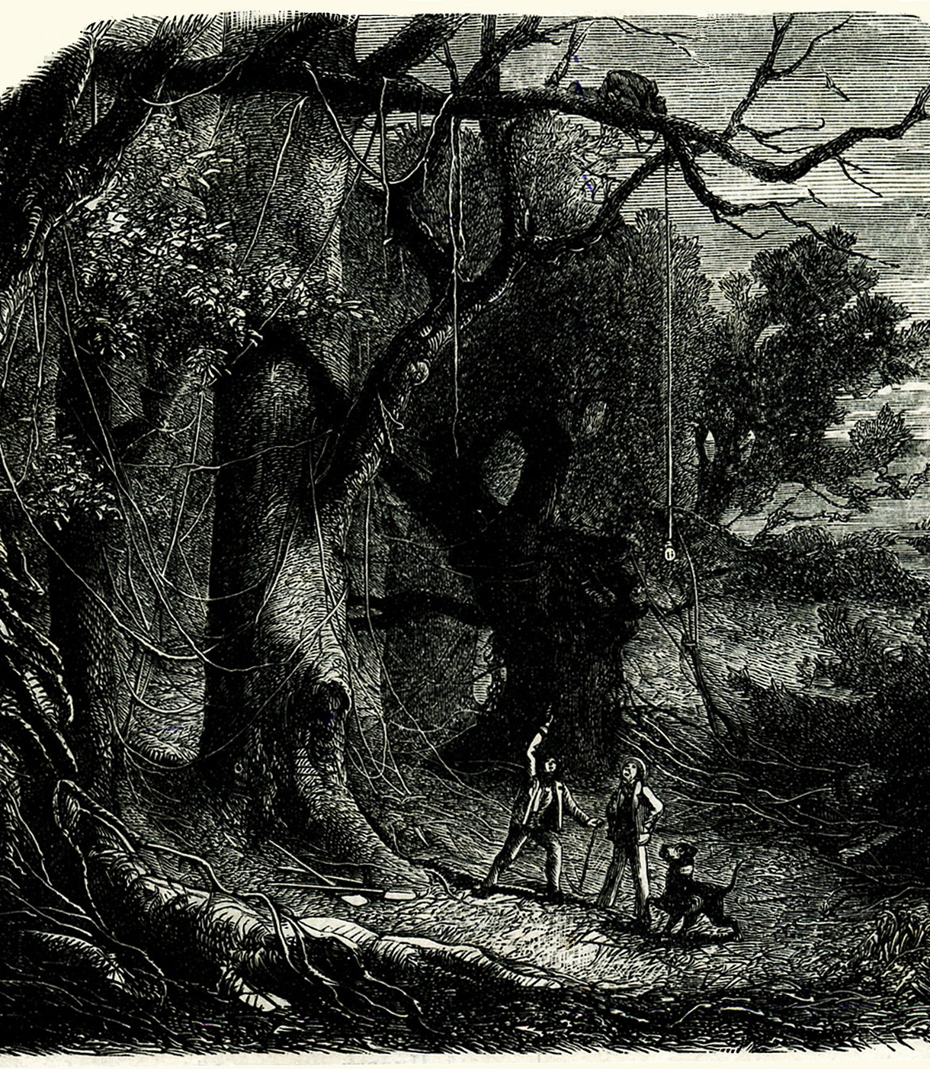
Historical Cryptography
Cryptography has existed since there has been writing:
Writing is a cipher to the illiterate and was once considered magical.
Typically involved one or more of the following:
Substituing one symbol for another,
Rearranging the order of the symbols, or
Using numbers to reference words in a known text.
An early popular example is The Gold Bug by Edgar Allan Poe.

Slide 9
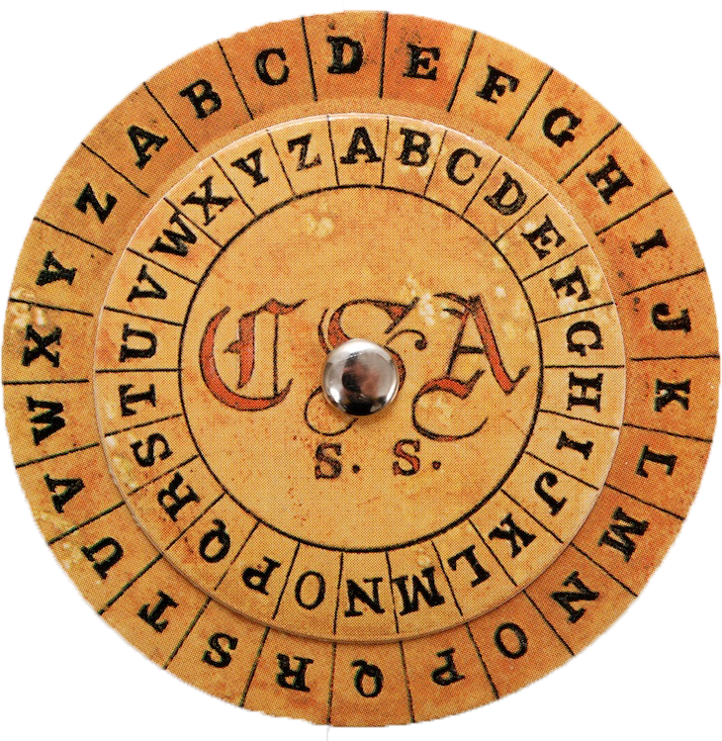
Secret Key Encryption
Also called symmetric-key encryption
Monoalphabetic substitution:
Each letter replaced by different letter.
Caesar Cipher.
Vigenère cipher (polyalphabetic):
THEMESSAGE ELMELMELME XSQQPEWLSI
These are easy to break.
Given the encryption key, it is easy to generate the decryption key.

Slide 10
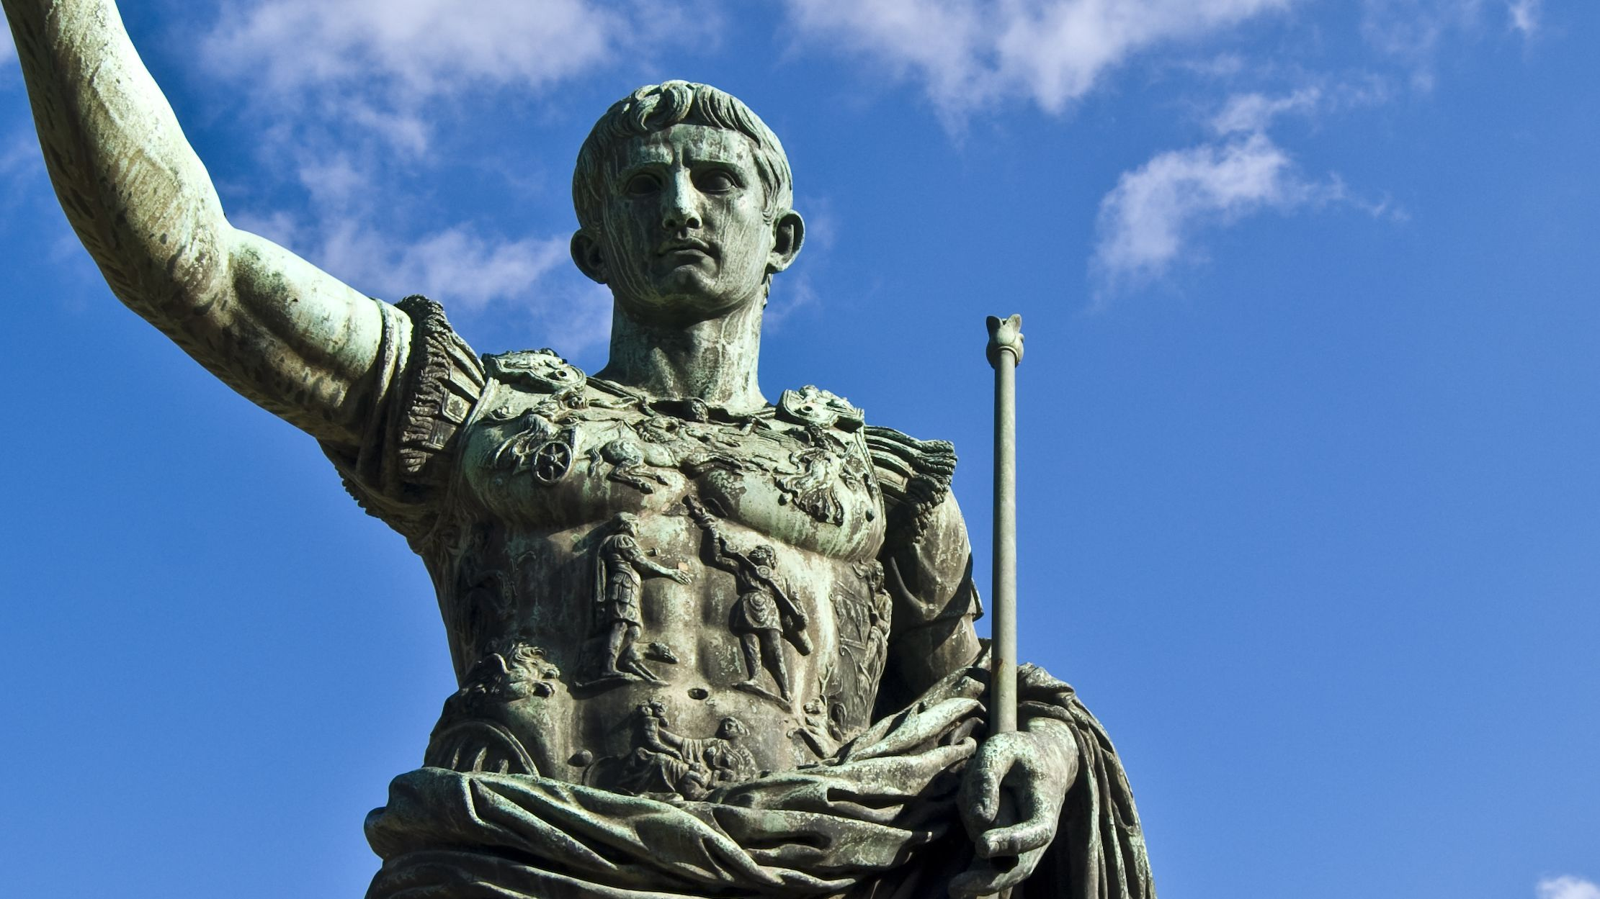
Caesar Cipher
Reputed to have been used during the Gallic Wars.
Replaces each letter with the letter three positions down, thus
It uses modular arithmetic.
Why did they use three?
Perhaps ancient Romans were not as good at arithmetic as the Greeks.
A B C D E F G H I K L M N O P Q R S T V X Y Z
↓ ↓ ↓ ↓ ↓ ↓ ↓ ↓ ↓ ↓ ↓ ↓ ↓ ↓ ↓ ↓ ↓ ↓ ↓ ↓ ↓ ↓ ↓
X Y Z A B C D E F G H I K L M N O P Q R S T V
↓ ↓ ↓ ↓ ↓ ↓ ↓ ↓ ↓ ↓ ↓ ↓ ↓ ↓ ↓ ↓ ↓ ↓ ↓ ↓ ↓ ↓ ↓
A B C D E F G H I K L M N O P Q R S T V X Y Z

Slide 11
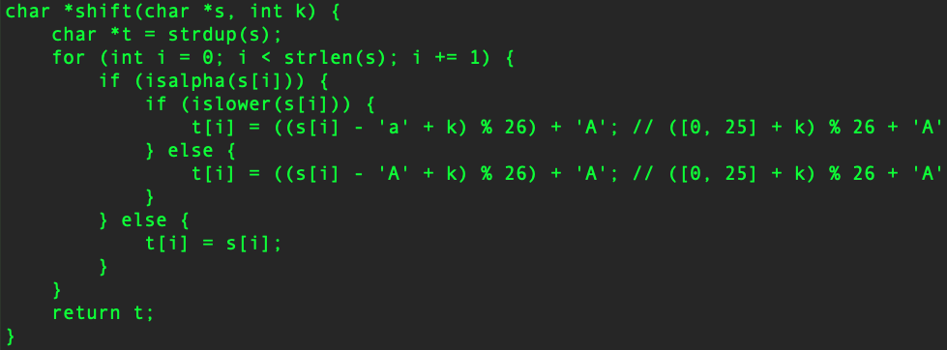
Caesar Cipher
Traditionally, the Caesar cipher replaces each letter with the letter three letters down.
This is a monoalphabetic substitution cipher.

Slide 12
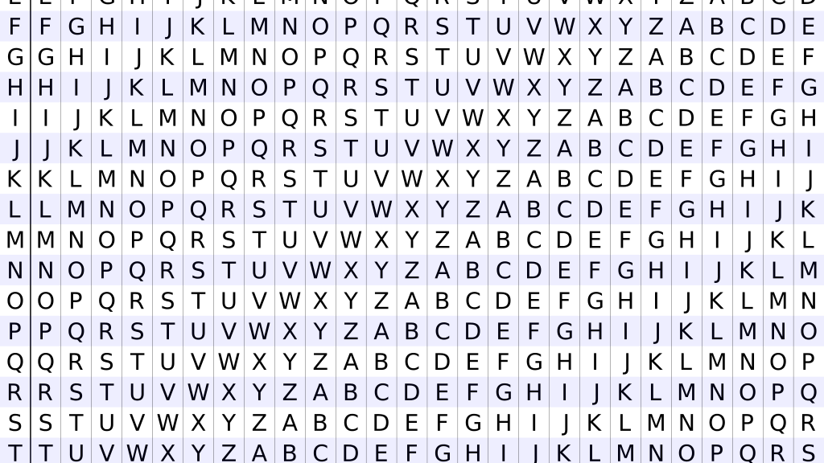
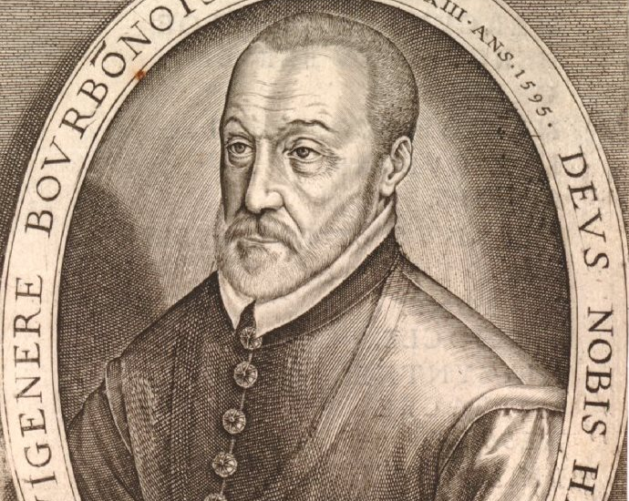

Vigenère Cipher
In this cipher, the key is a word and each letter is used to shift a letter of the clear text by its ordinal number positions.
To encrypt, a table of alphabets can be used, termed a tabula recta, Vigenère square or Vigenère table.
Algebraically,
$C_{i}=E_{K}\left(M_{i}\right)=\left(M_{i}+K_{i}+26\right) mod 26$
$M_{i}=D_{K}\left(C_{i}\right)=\left(C_{i}−K_{i}+26\right) mod 26$

Slide 13
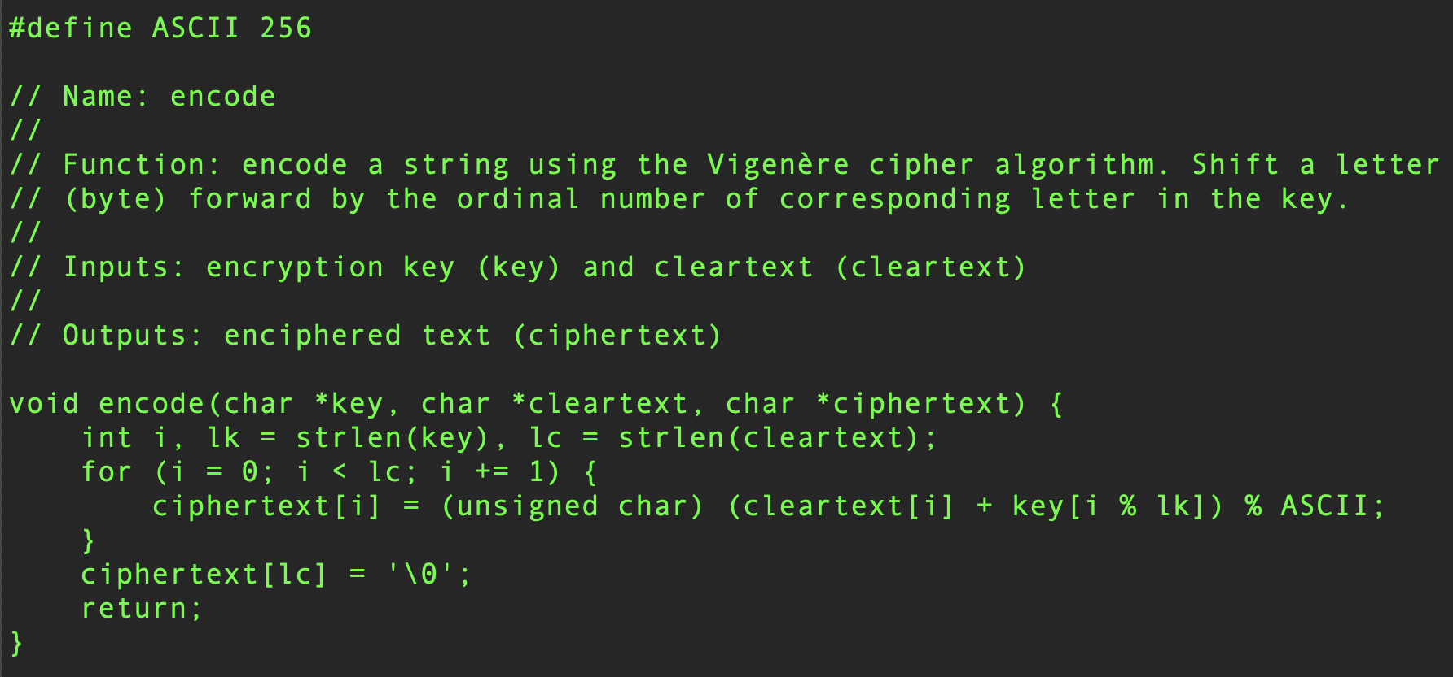
Vigenère Encode (adapted to ASCII)

Slide 14
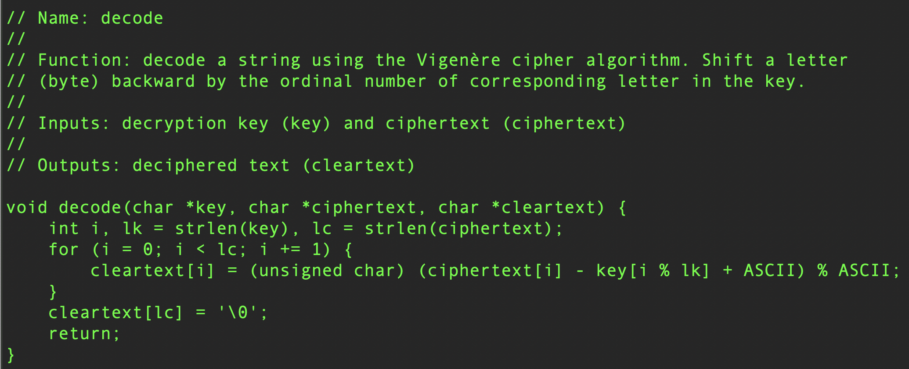
Vigenère Decode (Adapted to ASCII)

Slide 15
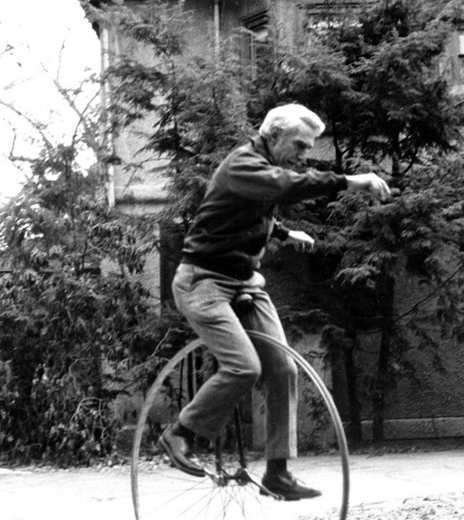
Unbreakable Codes
There is such a thing as an unbreakable code: It’s called the one-time pad.
Use a truly random key as long as the message to be encoded.
XOR the message with the key a bit at a time.
Code is unbreakable because
Key could be any string of bits.
The message could be any message given the appropriate key.
Difficulty: distributing the key is as hard as distributing message.
May be easier because of timing
Difficulty: generating truly random bits.
What does it mean to be random?
Claude Shannon

Slide 16
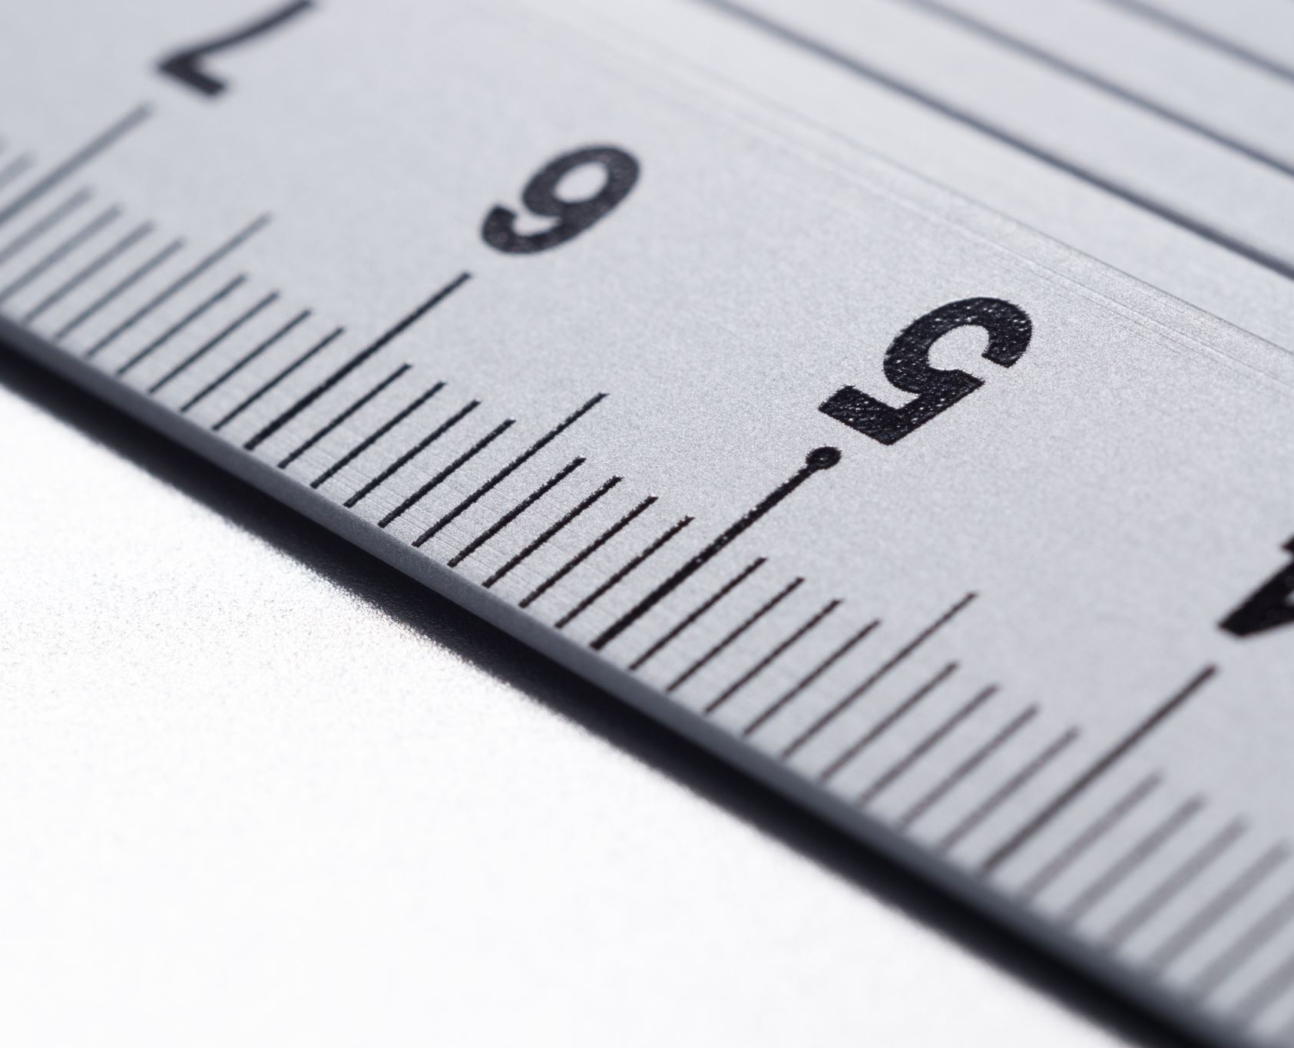
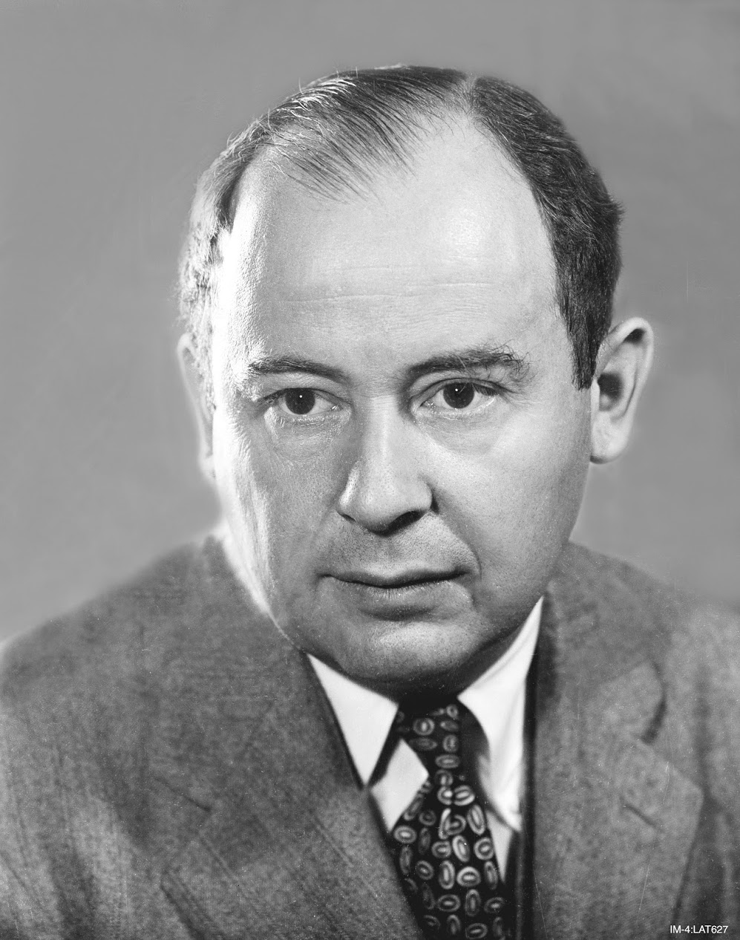
Random Numbers
Anyone who considers arithmetical methods of producing random digits is, of course, in a state of sin. —John von Neumann
True random numbers cannot be created using computers.
Why?
Programs are inherently deterministic.
It has the advantage of repeatability, but
It has the disadvantage of predictability.

Slide 17
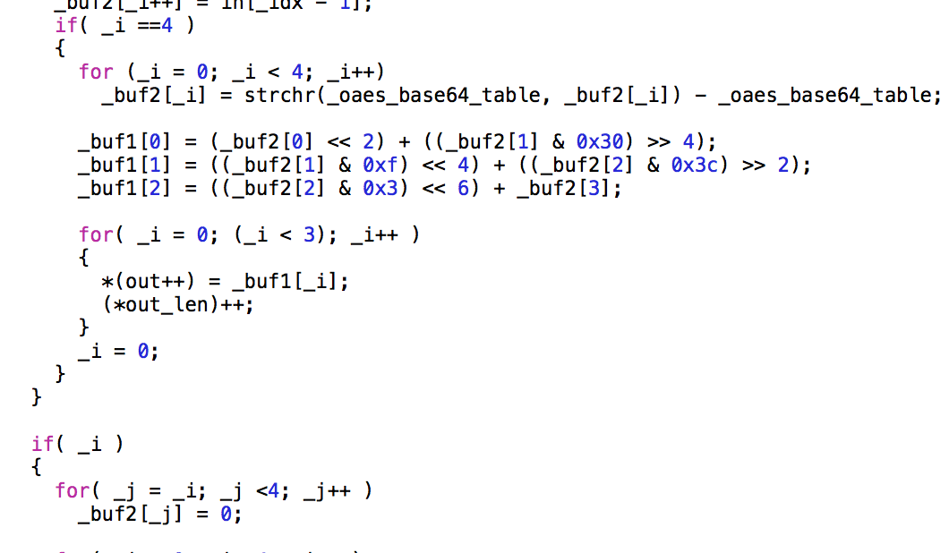
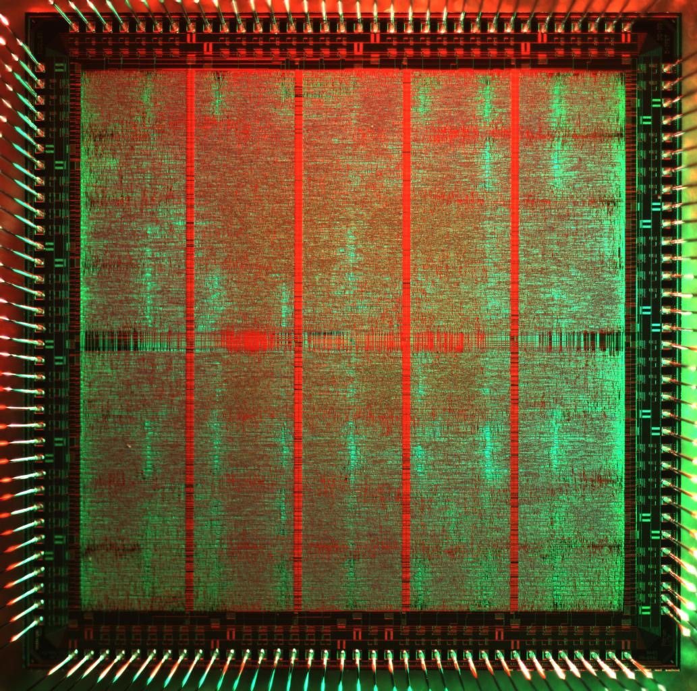
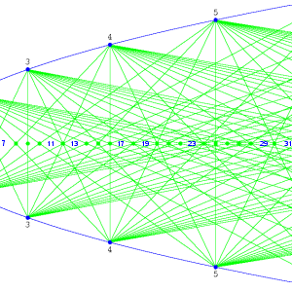
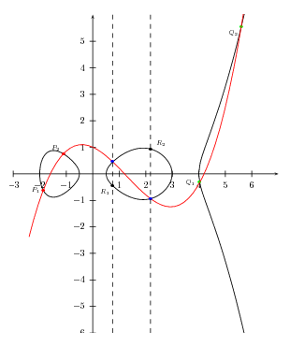
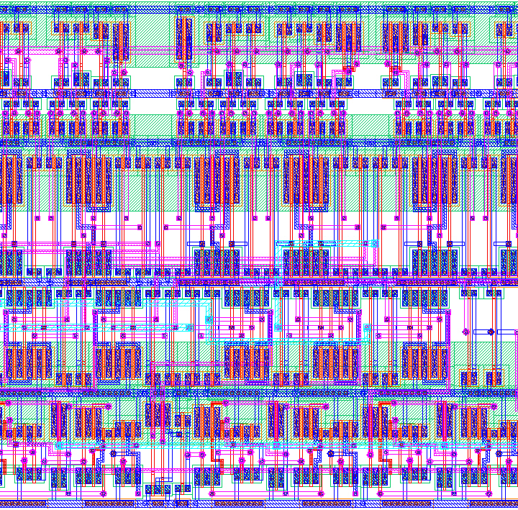
Modern Cryptography

Slide 18
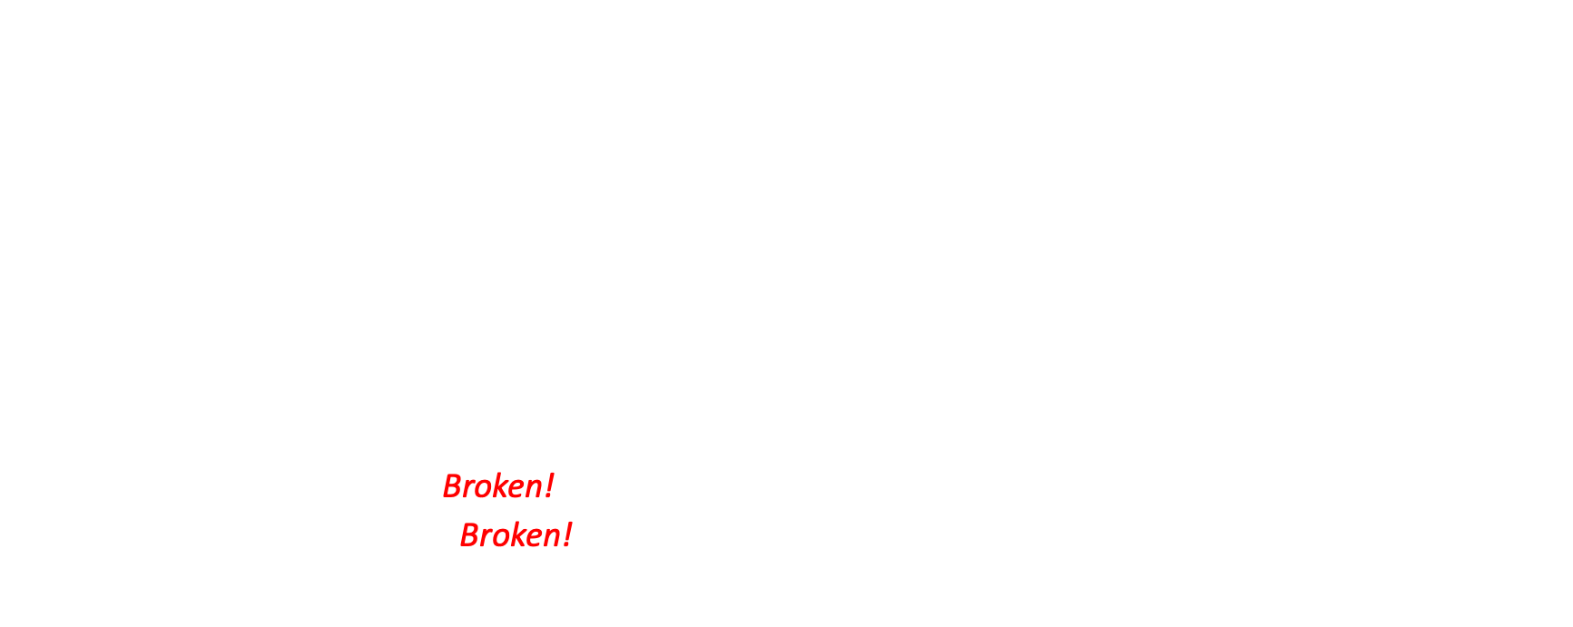
Cryptographic Hashing
A function such that:
Given formula for $f(x)$, easy to evaluate $y = f(x)$,
It is difficult to find collisions: two values of the same hash function.
Weak collision resistance: given $y$, hard to find $x$ such that $f(x) = y$.
Strong collision resistance: hard to find $x$ and $x′ ≠ x$such that $f(x) = f(x′).$
Often, these operate similar to encryption algorithms:
Produce fixed-length output rather than variable length output.
Changing one bit of input changes 50% of the output bits.
Common algorithms include:
MD5: 128-bit result – Broken!
SHA-1: 160-bit result – Broken!
SHA-3: 244–512-bit result

Slide 19
Modern Encryption Algorithms
Data Encryption Standard (DES) (1977)
Uses 56-bit keys
Same key is used to encrypt & decrypt
Needed to try 2⁵⁵ different keys, on average
But… Modern computers can try millions of keys per second with special hardware
Current algorithms (AES) use at least 128-bit keys
Adding one bit to the key makes it twice as hard to guess
Must try 2¹²⁷ keys, on average, to find the right one
At 10¹⁵ keys per second, this would require over 10²¹ seconds, or 1,000 billion years!
Modern encryption isn’t usually broken by brute force…

Slide 20
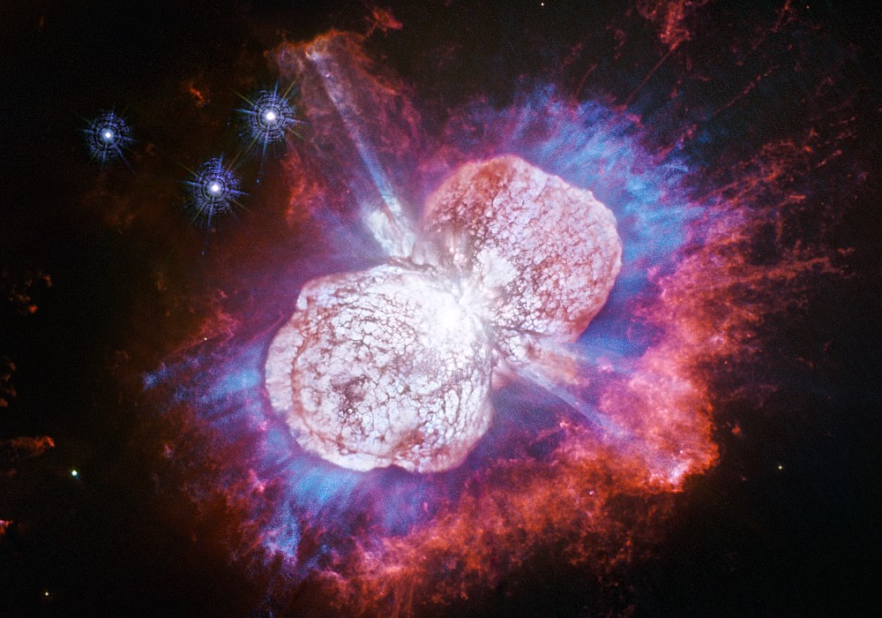
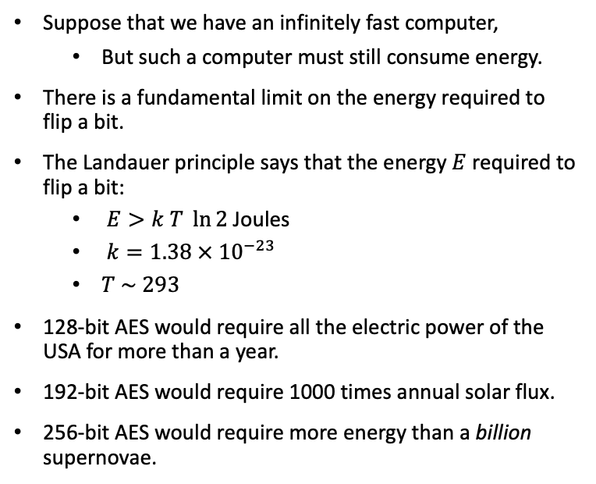
Attacking AES
Suppose that we have an infinitely fast computer,
But such a computer must still consume energy.
There is a fundamental limit on the energy required to flip a bit.
The Landauer principle says that the energy $E$ required to flip a bit:
$E>k T \ln{2}$ Joules
$k=1.38 × {10}^{−23}$
$T \sim 293$
128-bit AES would require all the electric power of the USA for more than a year.
192-bit AES would require 1000 times annual solar flux.
256-bit AES would require more energy than a billion supernovae.
$E>1.38×{10}^{−23}×293 ×\ln{2}×2^{255}≈1.62×{10}^{56}$ Joules

Slide 21
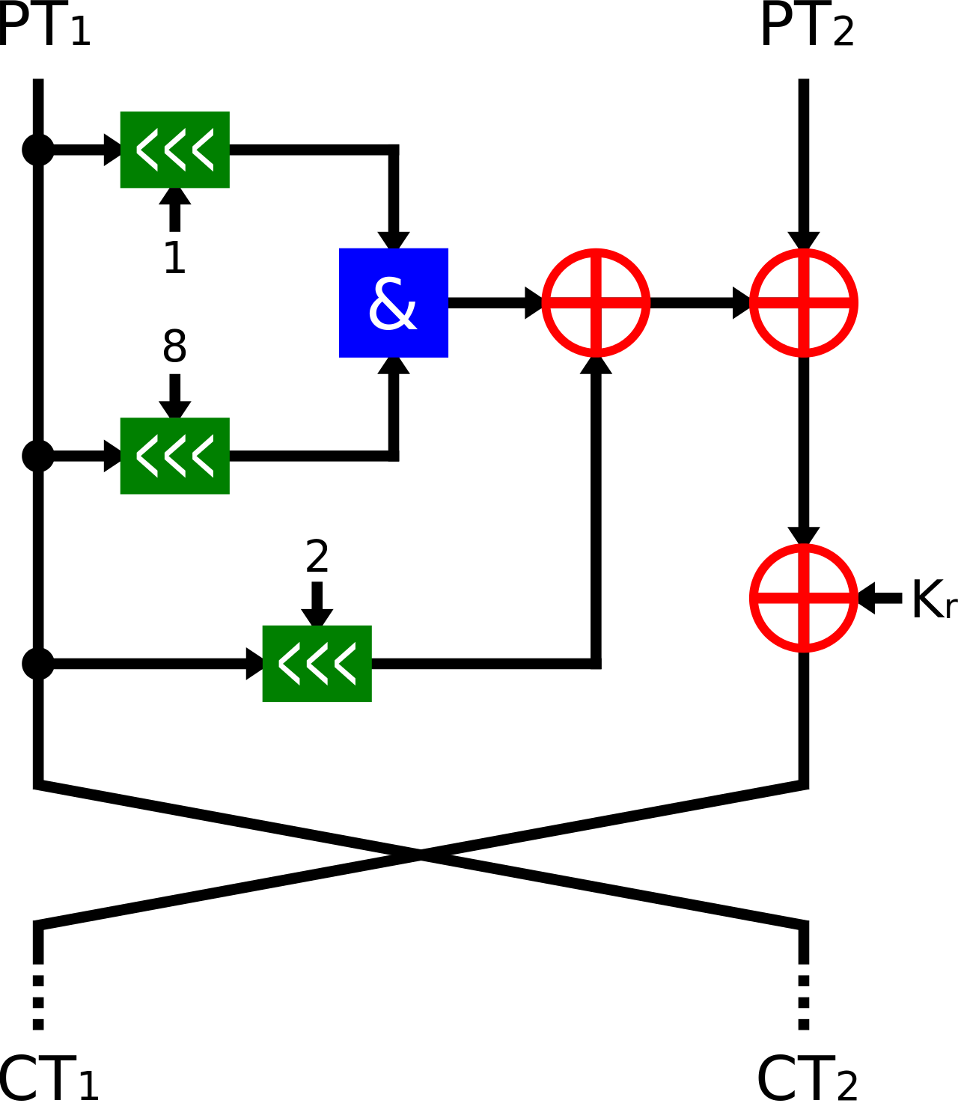

Simon
Simon is a family of lightweight block ciphers publicly released by the National Security Agency (NSA).
Simon is a balanced Feistel cipher with an $n$-bit word, and therefore the block length is $2n$.
As of 2018, no successful attack on full-round Simon of any variant is known.

Slide 22
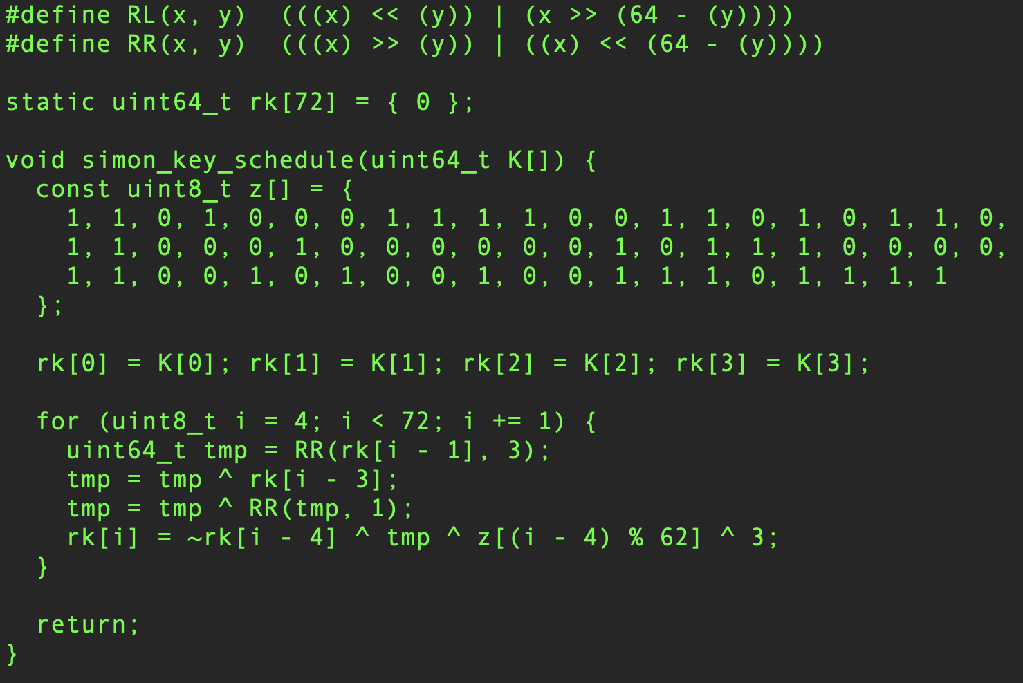
Simon (key schedule)

Slide 23
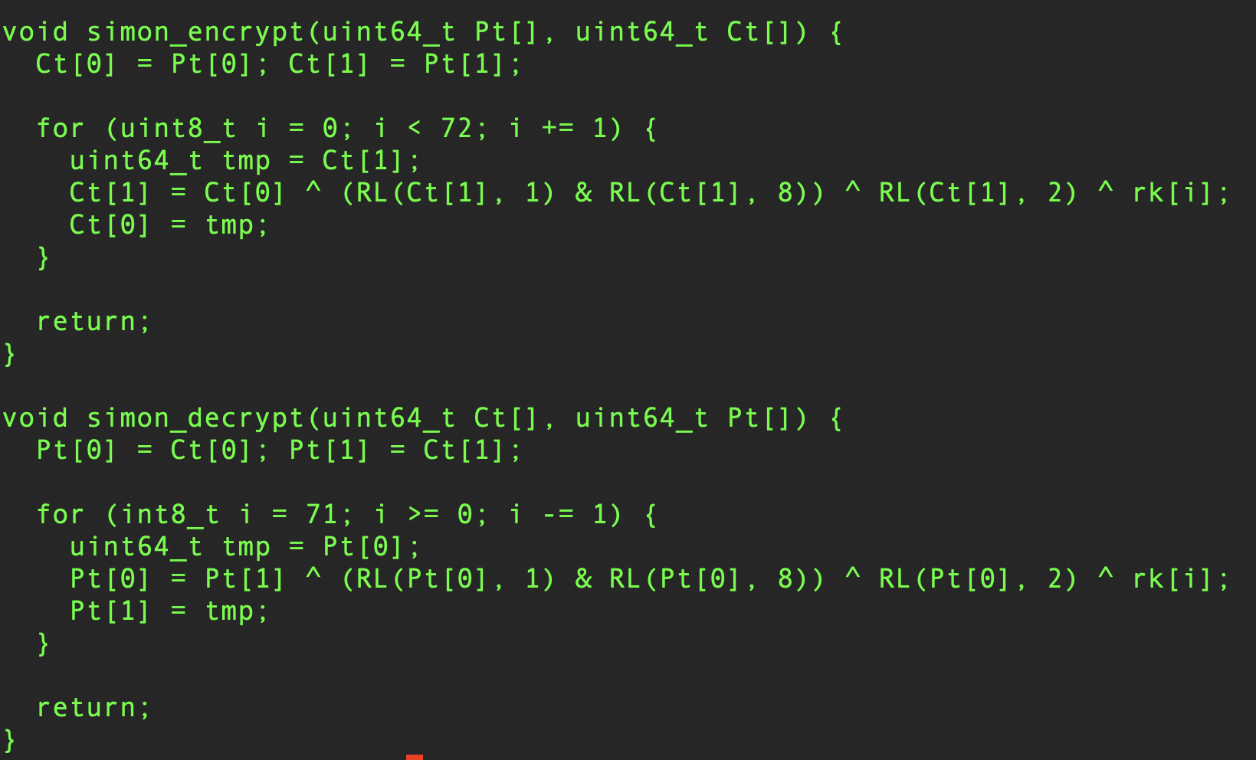
Simon (encrypt & decrypt)

Slide 24
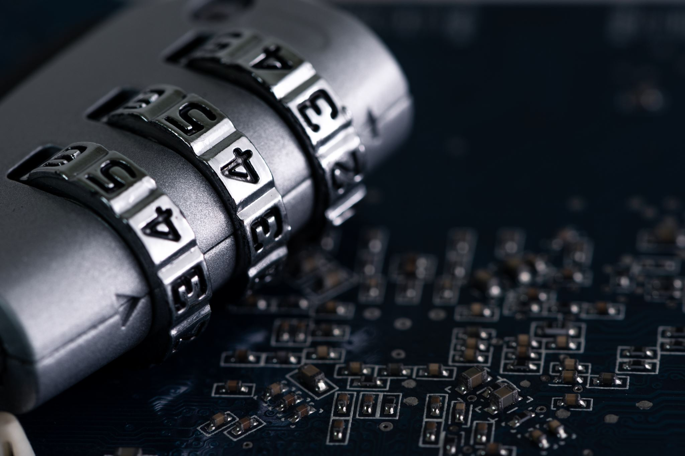
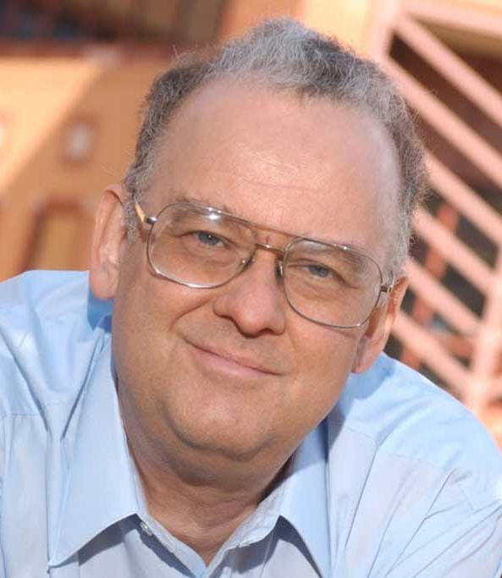

Public-key Cryptography
Instead of using a single shared secret, keys come in pairs:
The public key $K_{U}.$
The private key $K_{R}$.
$K_{U} ≠K_{R}.$
These keys are typically—but not always—inverses of one another.
Encryption & decryption are the same algorithm, so, typically:
$E\left(K_{U}, E\left(K_{R}, M\right)\right)=E\left(K_{R}, E\left(K_{U}, M\right)\right)=M$
Public key cryptography is usually slow.
Typically used for:
Encrypting small amounts of data, or
Establishing a shared key for symmetric encryption algorithms.
Currently, the most popular method, RSA, involves prime rings and exponentiation.
Security relies on the difficulty of factoring large composites.
Other methods involve discrete logarithms and elliptic curves.
Ralph Merkle

Slide 25
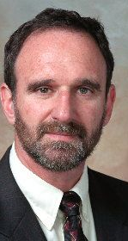
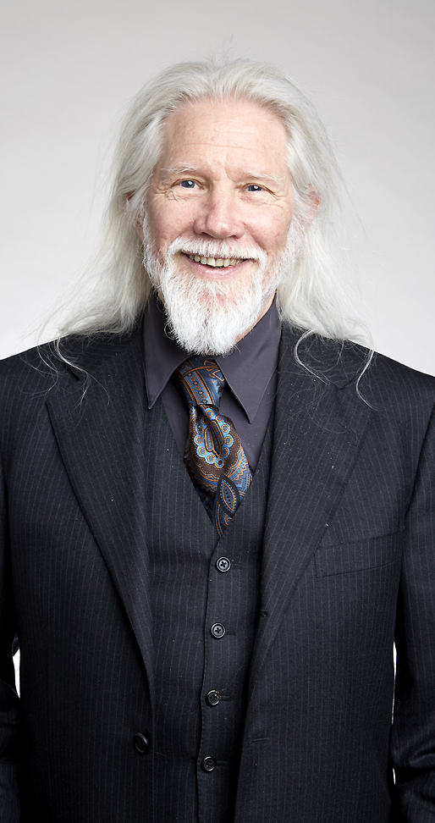
Diffie-Hellman Key Exchange
Named after Whitfield Diffie and Martin Hellman.
Credit to Ralph Merkle as well.
For securely exchanging keys over insecure channels.

Slide 26

Diffie-Hellman Key Exchange
Alice and Bob both agree on a public prime $p$ and some integer $g$, such that $g$ is a primitive root modulo $p$.
Alice chooses a private integer a and computes $A=g^{a} \text{(}\text{mod} p)$.
Bob chooses a private integer b and compute $B=g^{b} (\text{mod} p)$.
Alice and Bob share $A$and $B$ over the insecure channel.
Alice computes $K=B^{a} \text{(}\text{mod} p):$
$$K=B^{a}={(g^{a})}^{b}=g^{ab} \text{(}\text{mod} p)$$
Bob computes $K=A^{b}\text{ (}\text{mod} p):$
$$K=A^{b}={(g^{b})}^{a}=g^{ba} \text{(}\text{mod} p)$$
Alice and Bob have now created the shared key K.
$$K=g^{ab}=g^{ba} \text{(}\text{mod} p)$$

Slide 27

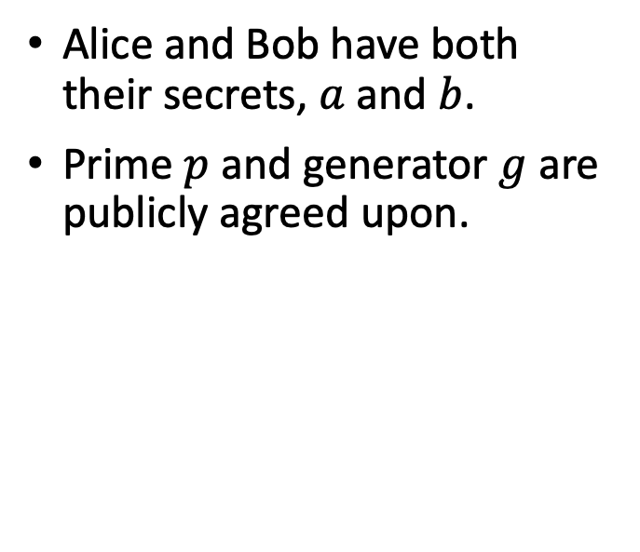


Diffie-Hellman Key Exchange
Alice and Bob have both their secrets, $a$ and $b$.
Prime $p$ and generator $g$ are publicly agreed upon.
Alice
Public Channel
Bob
$$a$$
$$p,g$$
$$b$$

Slide 28


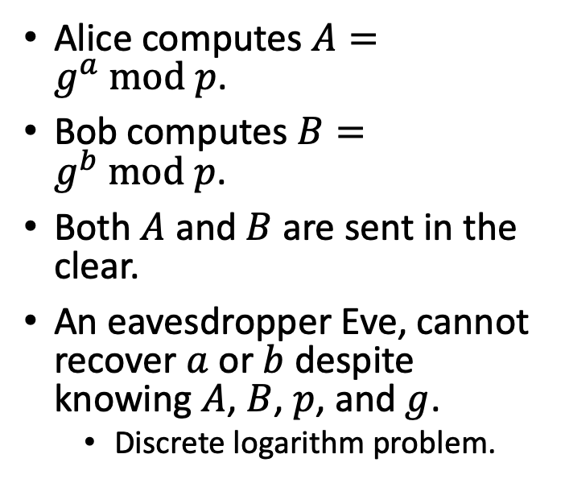

Diffie-Hellman Key Exchange
Alice computes $A=g^{a} \text{mod} p$.
Bob computes $B=g^{b} \text{mod} p$.
Both $A$ and $B$ are sent in the clear.
An eavesdropper Eve, cannot recover $a$ or $b$ despite knowing $A$, $B$, $p$, and $g$.
Discrete logarithm problem.
Alice
Public Channel
Bob
$$a$$
$$p,g$$
$$b$$
$$A$$
$$A, B$$
$$B$$

Slide 29



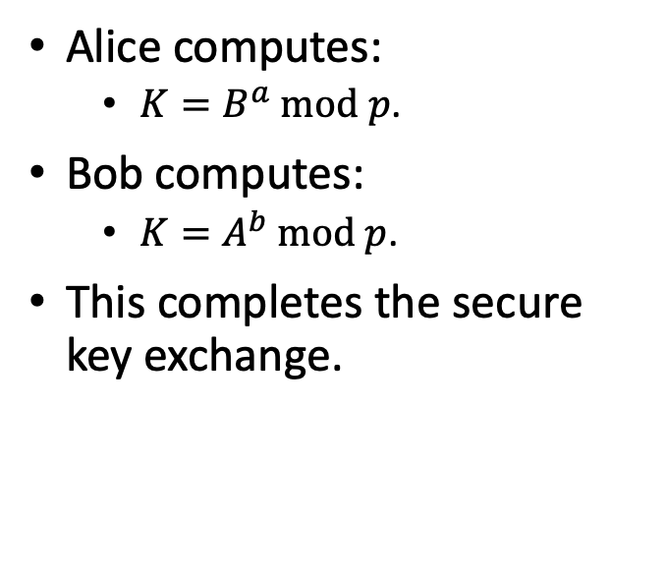


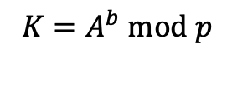

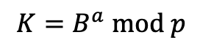
Diffie-Hellman Key Exchange
Alice computes:
$K=B^{a} \text{mod} p$.
Bob computes:
$K=A^{b} \text{mod} p$.
This completes the secure key exchange.
Alice
Public Channel
Bob
$$a$$
$$p,g$$
$$b$$
$$A$$
$$A, B$$
$$B$$
$$K=B^{a} \text{mod} p$$
$$K=A^{b} \text{mod} p$$

Slide 30
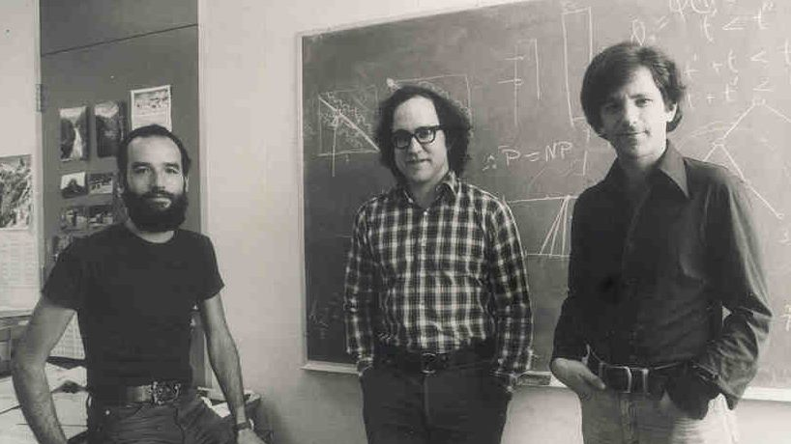

RSA
Choose two large primes $p$ and $q.$
These are secret, and temporary — you can throw them away.
Let $n=p × q$
$φ\left(n\right)=\left(p−1\right)\left(q−1\right)$
Choose a random $e$ such that $GCD\left(e, φ\left(n\right)\right)=1$
Calculate $d$ such that $e × d ≡1 (mod φ\left(n\right))$
$E\left(m\right)=m^{e}(mod n)$
$D\left(c\right)=c^{d}(mod n)$

Slide 31
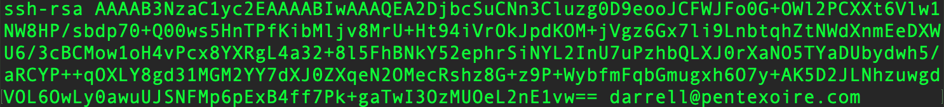

Attacking RSA
Requires factoring $n$ in order to find:
$φ\left(n\right)=(p−1 )(q−1)$.
Factoring of large composites is believed to be hard.
The best known algorithm is the Generalized Number Field Sieve:
$O(e^{\left(\sqrt[3]{\frac{64}{3}}+o\left(1\right)\right){(ln{n)}}^{\frac{1}{3 }}{(\ln{ln}{n)}}^{\frac{2}{3 }}})$
Here is my actual public key. You are welcome to try to factor it.

Slide 32
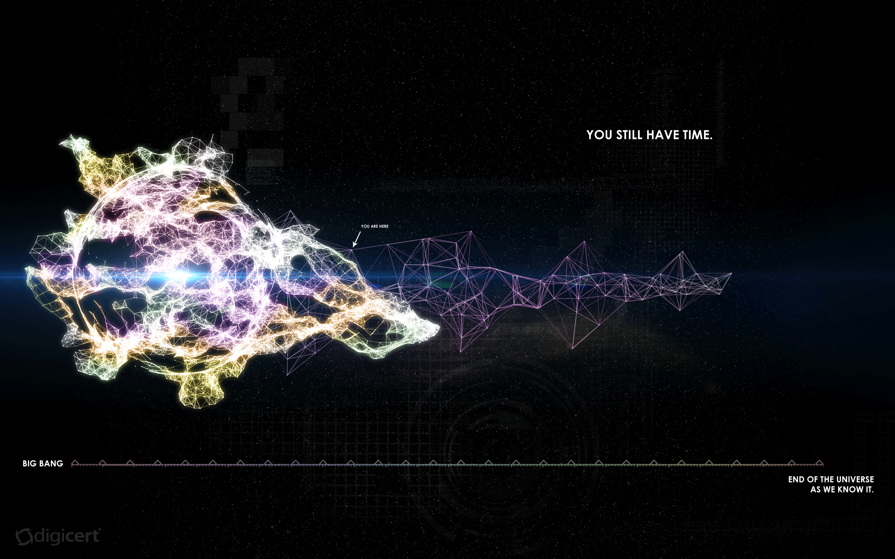
Attacking RSA
If you began factoring at the Big Bang using the best known algorithm and using all of the computers in the world…
Now

Slide 33

El Gamal Cryptosystem
Taher El Gamal was a student of Martin Hellman.
He invented this public key encryption system when he was in graduate school.
He is considered to be the father of SSL.
His cryptosystem became the basis for the Digital Signature Algorithm (DSA) adopted by National Institute of Standards and Technology (NIST) as the Digital Signature Standard (DSS).

Slide 34

El Gamal Key Generation
Generate an efficient description of a cyclic group $G$, of order $q$, with generator $g$.
Choose an integer $x$ randomly from $\{1, …, q−1\}.$
Compute $h =g^{x} \text{(}\text{mod} q)$.
The public key consists of the values $(G,q,g,h)$.
Alice publishes this public key and retains $x$ as her private key.

Slide 35

Keys

Slide 36

El Gamal Encryption
A second party, Bob, encrypts a message $M$ to Alice under her public key $(G,q,g,h)$ as follows:
Map the message $M$ to an element $m$ of $G$ using a reversible mapping function.
Choose an integer $y$ randomly from $\{1, …, q−1\}.$
Compute $s = h^{y} \text{(}\text{mod} q)$. This is the shared secret.
Compute $c_{1} = g^{y} \text{(}\text{mod} q)$.
Compute $c_{2} = m × s \text{(}\text{mod} q)$.
Bob sends the ciphertext $(c_{1},c_{2})$to Alice.

Slide 37

Encryption

Slide 38

El Gamal Decryption
Alice decrypts a ciphertext $(c_{1},c_{2})$ with her private key $x$ as follows:
Compute $s = c_{1}^{x} \text{(}\text{mod} q)$.
Since $c_{1} = g^{y}$, $c_{1}^{x} = g^{xy}= h^{y} \text{mod} q$ and it is the same shared secret that was used by Bob in encryption.
Compute $s^{−1}$, the inverse of $s$ in the group $G$.
The modular multiplicative inverse can be computed using the Extended Euclidean Algorithm.
$s × c_{1}^{q−x} = g^{xy} × g^{\left(q−x\right)y} = {\left(g^{q}\right)}^{y}=e^{y} = e \text{(}\text{mod} q)$.
Compute $m = c_{2} × s^{−1} \text{mod} q,$because $c_{2} = m × s \text{(}\text{mod} q)$:
$c_{2} × s^{−1} = \left(m × s\right)× s^{−1}= m × e = m \text{(}\text{mod} q)$.
Map $m$ back to the plaintext message $M$.

Slide 39

Decryption

Slide 40

Does it work?

Slide 41




How do you attack modern cryptography?
http://xkcd.com/538/
You Cheat!

Slide 42

When you can’t win playing by the rules, you change the rules!
You lie, you cheat.
You look for mistakes.
You look for bad assumptions.
You look for the weak spots:
The weakest spot is often the human …
So, who do you trust?

Slide 43

This is who you trust…
A whole lot of people that you do not know, that’s who!

Slide 44

Summary

